Slide 1
Class 23 Finance and Management
1. From perfect markets to incomplete contracts
2. Leveraged Buyouts
Controlling incentives through debt

Slide 2
Perfect Markets
Markets are perfect is equivalent complete contracts and no transactions costs
Shareholders can tell everyone in the firm exactly what they want to do in every situation that arises
and these contracts are free
In this case who initially owns the assets does not matter to the value of output. (Coase theorem)
Individuals will take actions to maximize the return of all assets
When markets are perfect there is still finance
Allocate capital
Talented individuals have finite wealth they will want to issue claims on those assets.
People want to save and spend
Allocate risk
Back to modules 2 and 3

Slide 3
Imperfect Markets
Incomplete contracts
You can’t write a contract that tells every employee what to do.
CEO and employees have discretion
Individuals maximize private return not firm return
Now who owns the firm matters
Who owns is who decides
Now compensation structure matters
Compensation produces incentives

Slide 4
Imperfect Markets (2)
Who owns the firm
Firms with dispersed ownership face a double tragedy of the commons
Shareholders
Costly to monitor so rather have someone else do it.
Ideal is one-owner firm
Employees
Rather put in less effort than more
Compensation structure

Slide 5
Solving these problems through finance
If there should be a single owner, there are multiple ways of doing so.
An all equity deal (see Comcast) with a dominant owner. Majority-owner decides. Incentives on non contractible investment are positive for both sides (because they each own roughly half the firm).
Problem each owner gets 50% of the value of their effort.
Question who buys whom?
If everything is symmetric then it does not matter
If not the party that is more important than the other should own (because decision rights matter).

Slide 6
Debt vs equity
When minority owns equity
Still have a problem.
But less risk for the majority
Alternative: one party buys the other firm with debt (or cash).
Owner decides who does what so no fear of hold up,
Owner has no distortion at margin
Seller makes no effort

Slide 7
Paramount buys Warner
Paramount will pay $31.00 per share in cash for all outstanding shares of WBD. ($110 Billion)
Paramount issuing $47 billion of new Class B shares at $16.02 per share, supported by a fully committed investment from the Ellison Family and RedBird Capital Partners
Prior bids ($ per share)
Paramount Sept 25 $19 (67% cash 33% equity)
Paramount October 25 $23.5 (80% cash 20% equity)
Netflix November 25 $27.5 (most but not all of the company)
December Warner accepts Netflix
Paramount December 5 $30(cash)
Netflix November 25 $27.5 (cash)
Two things at stake? How much to pay and how to pay
Battle of egos or what is most efficient?
Both Netflix and Paramount (via Oracle) have vast resources (both $400 billion companies)

Slide 8
Example: Leveraged buy outs
Late 1970s liberalization of bond markets allow issuers to sell junk (not investment grade) bonds.
Used in a variety of settings.
In particular to do high risk project
Leveraged Buy Out market.
In theory entrepreneur identifies an underperforming firm, has business plan to turn it around.
Makes a tender offer for the stock that is based on borrowing nearly all the total expense of buying the stock.
Takes a firm with low leverage and turns it into a firm with very high leverage.

Slide 9
Leveraged buy out
The owners of the firm before the LBO have an option at strike price B_{L}
Can afford to pick low risk low return project
LBO buys out the equity and old debt with debt sold at a fraction of par
So B_{H} > B_{L} +E Difference between what they owe and what they spent.
The owners of the firm after the LBO have an option at a much higher strike price B_{H}
So they have to generate higher profits to be in the money.
If they fail, the firm becomes bankrupt and control passes to creditors
The higher the leverage of the LBO the stronger the incentives!

Slide 10
Making the LBO work
To get to profits above B_{H} management can
Find assets that would fetch a higher price on the market than their present value in the firm
Implement cost savings
Increase sales
Innovate
Hope for interest rate drop
Last one is rare and most of the gains come from the first two
LBO firms have specialized expertise, they are turn-around specialists
Usually little sector-specific experience
Other sources of profits are interest rate declines,
Bonds are callable. (the firm has a call option on the bonds at par)

Slide 11
Example Dell
Was for while the largest seller of PC in the world
In the past few years has missed its targets.
In July 2013 has about 7 billion dollars in debt and 10 billion dollars in equity.
In 2012 ago founder Michael Dell and an investment firm propose an LBO to take the company private.
Buy out the company for 24.9 Billion dollars in cash and issue bonds for about 20 billion dollars moving to a very high degree of leverage. (13% to 90%)
The idea is that the company that was once the largest seller of PC needs change
hard choices
it will take a bit of time…
If they succeed they will make a fortune. If not..
Return to the market in 2016 at 35 billion. Peek in late 2021 at 82 billion

Slide 12
Since returning to the market

Slide 13
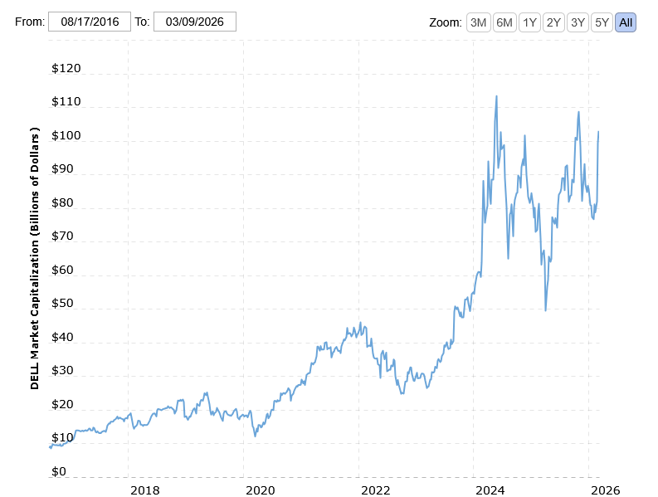
Value of equity
 | Equity | Debt | Ratio
2016 | 35.1 | 47.2 | 134.47%
2017 | 62 | 44 | 70.97%
2018 | 35.1 | 40.5 | 115.38%
2019 | 37.89 | 44.32 | 116.97%
2021 | 42.9 | 31.7 | 73.89%
2022 | 28.8 | 20.5 | 71.18%
2023 | 54.43 | 20.1 | 36.93%
2024 | 64.67 | 20.1 | 31.08%
2025 | 71.7 | 19.4 | 27.06%
2026 | 98 | 31.5 | 32.145
https://www.macrotrends.net/stocks/charts/DELL/dell/market-cap

Slide 14
QUIZ 8

